Slide 1


Looking for Pre-Supernova Outbursts in the DLT40 Survey
Steven Zhou-Wright
Mentored by David Sand at Steward Observatory
Arizona Space Grant Symposium April 12th 2019

Slide 2
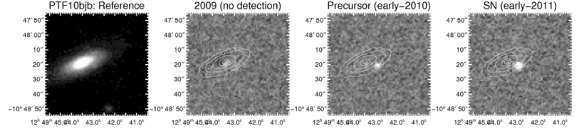

What is a Pre-Supernova Outburst?
Sudden flare of light preceding the supernovae
Possible causes include sudden brightness increase at surface of star or star mass hitting gas and dust floating around star (circumstellar medium)
Image Credit: Ofek, E., et al (2014). “Precursors prior to Type IIn supernova explosions are common: precursor rates, properties, and correlations”
Notes:
1/3rd of a year before explosion, according to Olek. CSM may be ejected by star in early outbursts.

Slide 3
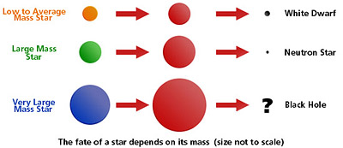
Why do we care? Massive Star Death!
Final stages of stellar evolution: what is happening inside the star?
How do massive stars spend their final years?
What exactly are the mechanisms of a supernova explosion?
Image Credit: NASA from https://www.nasa.gov/audience/forstudents/9-12/features/stellar_evol_feat_912.html

Slide 4
Other Potential Benefits
Better understanding of circumstellar medium
Possible prediction of supernovae
Better classification of supernovae

Slide 5
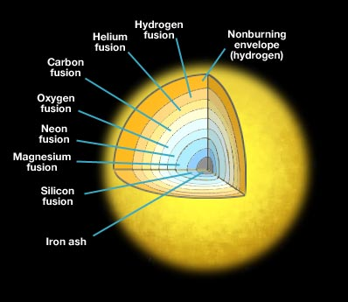
Stellar Death: The Simplified View
Stars that are big enough fuse Hydrogen to Helium, Helium to Carbon, and so on until fusing Silicon to Iron.
Silicon to Iron fusion generates less energy than it requires, so the star collapses into itself. This causes the supernova.
Does not explain the pre-supernova outbursts.
Image Credit: Penn State Astronomy & Astrophysics
Notes:
Silicon to Iron fusion requires < 1 day to complete. This process, particularly the supernova itself, is responsible for generating many elements heavier than iron, including gold.

Slide 6
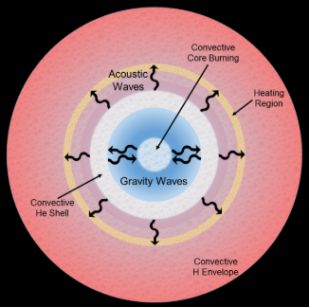
Stellar Death: Wave Heating
Convection of hot core material generates acoustic waves
Waves can’t propagate all the way through hydrogen, and dissipate into heat
Heated hydrogen puffs up and ejects mass
Most massive stars should experience this.
Image Credit: Fuller, J. (2017). “Pre-Supernova Outbursts via Wave Heating in Massive
Stars I: Red Supergiants”
Notes:
Most RSGs should experience this, meaning most supernovae should

Slide 7
Stellar Death: Other Processes
Convection fluctuations in shell-fusion
Magnetic field emission because of core dynamo
Early silicon to iron fusion in parts of the star
Neutrino emission leading to mass loss
Which one is it?
Notes:
The answer is that we don’t know. It could be one, none, or some combination of te proposed processes.The wave-heating hypothesis appears to support what we see, but it predicts that most supernova created by large stars should show these pre-SN outbursts.

Slide 8
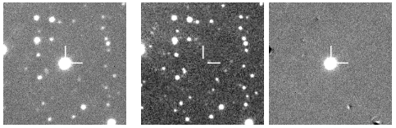
DLT40 and the Search for Pre-SN Outbursts
The Distance Less Than 40 (megaparsecs) survey is dedicated to finding supernovae less than a day after they explode
This leaves us with a lot of images where supernova hasn’t happened yet but does later on
Could there be pre-explosion outbursts in these images?
Image Credit: DLT40 Survey
Notes:
We can’t see pre-explosion outbursts with our naked eye, because they’re too dim. But with aperture photometry, we don’t need to look at with our eyes.

Slide 9
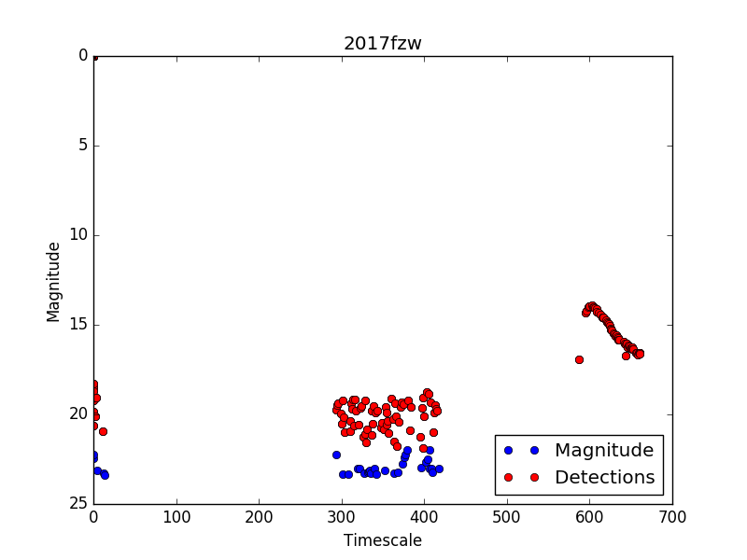
Aperture Photometry
Make a Python script to count how many photons hit the detector, and see if any hit where the supernova progenitor is.
If the script counts more photons than those that come from the sky, then maybe there was a pre-explosion outburst.
Are these red dots all actual detections?
Notes:
The answer is that I still don’t know. There are a number of ways for a false positive to appear while performing this photometry.

Slide 10
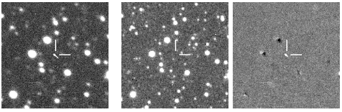
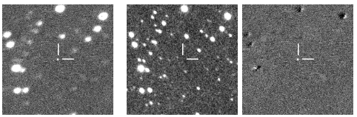
Challenges with Python Photometry
Cosmic rays, which have to be removed from the image
Persistence which has to be ignored
Image Credits: DLT40 Survey

Slide 11
Acknowledgements
Thank you to David Sand and Sam Wyatt for mentoring and indispensable aid over the course of the project. I would also like to thank the Arizona Space Grant Program and the peer mentors.
Thank you to NASA and Steward Observatory, without which I would not be pursuing astronomical research.

Slide 12
Thank You!

